Slide 1
ECE408 Spring 2018 Applied Parallel Programming Lecture 17 Parallel Computation Patterns – Parallel Scan Part-2

Slide 2
Objective
To master parallel scan (prefix sum) algorithms
Work-efficiency vs. latency
Brent-Kung Tree Algorithm
Hierarchical algorithms

Slide 3
A Kogge-Stone Parallel Scan Algorithm
T | 3 | 1 | 7 | 0 | 4 | 1 | 6 | 3
Stride = 1
T | 3 | 4 | 8 | 7 | 4 | 5 | 7 | 9
Stride = 2
T | 3 | 4 | 11 | 11 | 12 | 12 | 11 | 14
Stride = 4
T | 3 | 4 | 11 | 11 | 15 | 16 | 22 | 25

Slide 4
Improving Efficiency
A common parallel algorithm pattern:
Balanced Trees
Build a balanced binary tree on the input data and sweep it to and from the root
Tree is not an actual data structure, but a concept to determine what each thread does at each step
For scan:
Traverse down from leaves to root building partial sums at internal nodes in the tree
Root holds sum of all leaves
Traverse back up the tree building the scan from the partial sums

Slide 5
Brent-Kung Parallel Scan - Reduction Step
x₀
x₁
x₂
x₃
x₄
x₅
x₆
x₇
+
+
+
+
Time
∑x_{0..}x₁
∑x_{2..}x₃
∑x_{4..}x₅
∑x_{6..}x₇
+
+
∑x_{0..}x₃
∑x_{4..}x₇
+
In place calculation
∑x_{0..}x₇
Final value after reduce

Slide 6
Inclusive Post-Scan Step
x₀
∑x_{0..}x₁
x₂
∑x_{0..}x₃
x₄
∑x_{4..}x₅
x₆
∑x_{0..}x₇
+
∑x_{0..}x₅
Move (add) a critical value to a central location where it is needed

Slide 7
Inclusive Post Scan Step
x₀
∑x_{0..}x₁
x₂
∑x_{0..}x₃
x₄
∑x_{4..}x₅
x₆
∑x_{0..}x₇
+
∑x_{0..}x₅
+
+
+
∑x_{0..}x₂
∑x_{0..}x₄
∑x_{0..}x₆

Slide 8
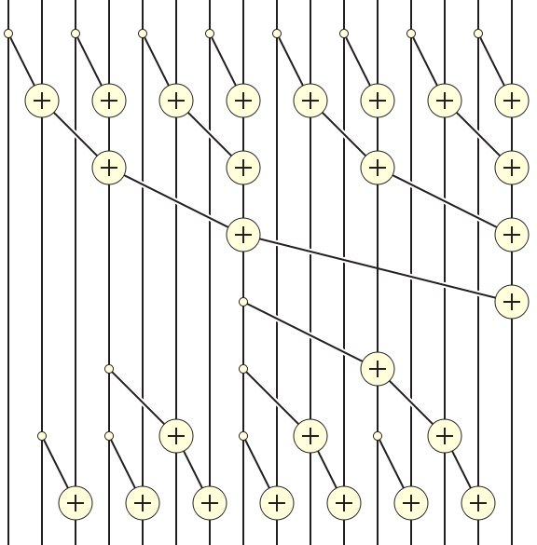
Putting it Together (Data View)
x₀
x₁
x₂
x₃
x₄
x₅
x₆
x₇
x₈
x₉
x₁₀
x₁₁
x₁₂
x₁₃
x₁₄
x₁₅

Slide 9
Reduction Step Kernel Code
// float T[2*BLOCK_SIZE] is in shared memory
// for previous slide, BLOCK_SIZE is 8
int stride = 1;
while(stride < 2*BLOCK_SIZE)
{
__syncthreads();
int index = (threadIdx.x+1)*stride*2 - 1;
if(index < 2*BLOCK_SIZE && (index-stride) >= 0)
T[index] += T[index-stride];
stride = stride*2;
}

Slide 10
Reduction Step Kernel Code
// float T[2*BLOCK_SIZE] is in shared memory
int stride = 1;
while(stride < 2*BLOCK_SIZE)
{
int index = (threadIdx.x+1)*stride*2 - 1;
if(index < 2*BLOCK_SIZE && (index-stride) >=0)
T[index] += T[index-stride];
stride = stride*2;
__syncthreads();
}
// For previous example,
// threadIdx.x+1 = 1, 2, 3, 4, 5, 6, 7,8
// stride = 1, index = 1, 3, 5, 7, 9, 11, 13, 15

Slide 11
Putting it Together

Slide 12
Post Scan Step
int stride = BLOCK_SIZE/2;
while(stride > 0)
{
__syncthreads();
int index = (threadIdx.x+1)*stride*2 - 1;
if((index+stride) < 2*BLOCK_SIZE)
{
T[index+stride] += T[index];
}
stride = stride / 2; // for the previous example,
// BLOCK_SIZE is 8
// stride will go 4, 2, 1
// for the first iteration, the active thread
} // will be thread 0, with index = 7 and
// index+stride = 11

Slide 13
Work Analysis
The parallel Inclusive Scan executes 2* log(n) parallel iterations
log(n) in reduction and log(n) in post scan
The iterations do n/2, n/4,..1, (2-1), …., (n/4-1), (n/2-1) useful adds
In our example, n = 16, the number of useful adds is 16/2 + 16/4 + 16/8 + 16/16 + (16/8-1) + (16/4-1) + (16/2-1)
Total adds: (n-1) + (n-2) – (log(n) -1) = 2*(n-1) – log(n)→ O(n) work
The total number of adds is no more than twice of that done in the efficient sequential algorithm
The benefit of parallelism can easily overcome the 2X work when there is sufficient hardware

Slide 14
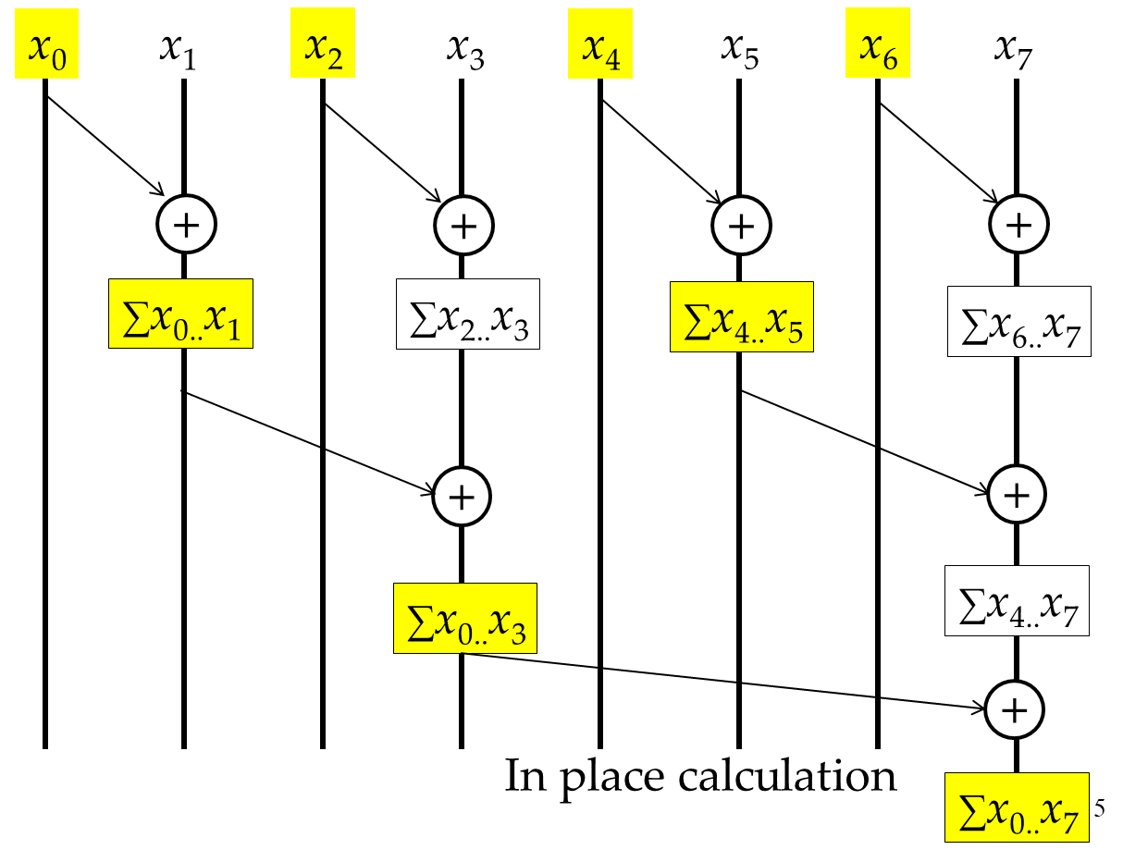
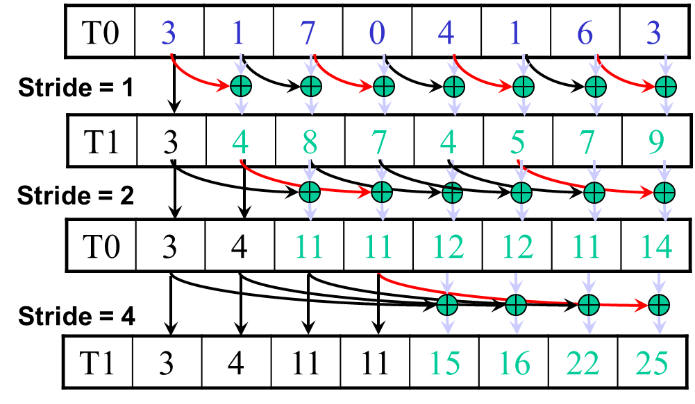
Kogge-Stone vs. Brent-Kung
Brent-Kung uses half the number of threads compared to Kogge-Stone
Each thread should load two elements into the shared memory
Brent-Kung takes twice the number of steps compared to Kogge-Stone
Kogge-Stone is more popular for parallel scan with blocks in GPUs

Slide 15
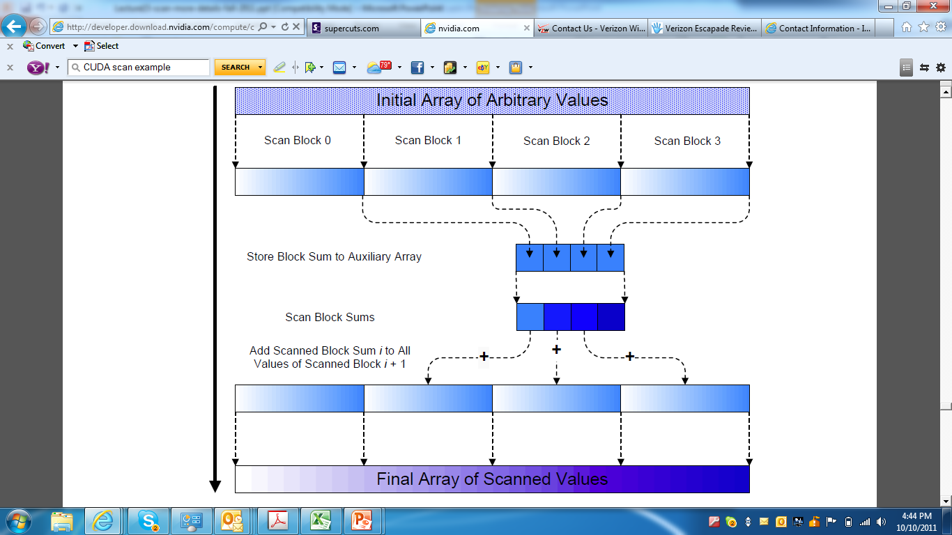
Overall Flow of Complete Scan A Hierarchical Approach
Scan
kernel

Slide 16
Using Global Memory Contents in CUDA
Data in registers and shared memory of one thread block are not visible to other blocks
To make data visible, the data has to be written into global memory
However, any data written to the global memory are not visible until a memory fence. This is typically done by terminating the kernel execution
Launch another kernel to continue the execution. The global memory writes done by the terminated kernels are visible to all tead blocks.

Slide 17
Scan of Arbitrary Length Input
Build on the scan kernel that handles up to 2*blockDim.x elements from Brent-Kung
For Kogge-Stone, have each section of blockDim.x elements assigned to a block
Have each block write the sum of its section into a Sum array using its blockIdx.x as index
Run parallel scan on the Sum array
May need to break down Sum into multiple sections if it is too big for a block
Add the scanned Sum array values to the elements of corresponding sections

Slide 18
Overall Flow of Complete Scan A Hierarchical Approach
Kernel
Kernel
Kernel

Slide 19
(Exclusive) Scan Definition
Definition: The exclusive scan operation takes a binary associative operator ⊕, and an array of n elements
[x₀, x₁, …, x_{n-1}]
and returns the array
[0, x₀, (x₀ ⊕ x₁), …, (x₀ ⊕ x₁ ⊕ … ⊕ x_{n-2})].
Example: If ⊕ is addition, then the exclusive scan operation on [3 1 7 0 4 1 6 3],
would return [0 3 4 11 11 15 16 22].

Slide 20
Why Exclusive Scan
To find the beginning address of allocated buffers
Inclusive and Exclusive scans can be easily derived from each other; it is a matter of convenience
[3 1 7 0 4 1 6 3]
Exclusive [0 3 4 11 11 15 16 22]
Inclusive [3 4 11 11 15 16 22 25]

Slide 21
A simple exclusive scan kernel
Adapt an inclusive, Kogge-Stone scan kernel
Block 0:
Thread 0 loads 0 into (shared) XY[0]
Other threads load (global) X[threadIdx.x-1] into XY[threadIdx.x]
All other blocks:
All thread load X[blockIdx.x*blockDim.x+threadIdx.x-1] into XY[threadIdex.x]
Similar adaption for Brent-Kung kernel but pay attention that each thread loads two elements
Only one zero should be loaded
All elements should be shifted by only one position
Intellectual contribution vs. practical contribution

Slide 22
Any More Questions? Read Chapter 8

